Slide 1



Salfatix
December 2017

Slide 2
Brand Subscription
Influencer Subscription
Brand
Subscribe
Mail
Refine Subscription
Notify
Accept
Yes
Notify
Accept
Salfatix
Media
No
Check Subscription
Ok
Yes
Check profile
Ok
Cancel Account
Missing Information
No
Notify
Reject
Cancel
Refine profile
Log in
Populate profile
Submit profile
Mail
Influencer

Slide 3
Campaign Creation
Post Deal + Entrance fee
Mail
Post Deal + Entrance fee
Post Deal + Entrance fee
Post Deal + Entrance fee
Post Deal + Entrance fee
Post Deal + Entrance fee ?
Pay (CB or Transfer)
Change budget, Change influencers
Validate Selection
Validate Selection
Validate Selection
Validate Selection
Validate Selection
Brand
Validate Selection
Brand
Brand
Brand
Brand
Brand
Ok
Refine Deal
If X>0
Enter accept list
Salfatix
Media
Salfatix
Media
Salfatix
Media
Salfatix
Media
Salfatix
Media
Salfatix
Media
Got it?
Select Influencers
Propose Influencers
Propose Influencers
Propose Influencers
Propose Influencers
Propose Influencers
Propose Influencers
Notify Influencers
Notify Influencers
Notify Influencers
Notify Influencers
Notify Influencers
Notify Selected Influencers
Prioritize Influencers
Notify Influencers
Prioritize Influencers
Prioritize Influencers
Prioritize Influencers
Prioritize Influencers
No
Request
X% of budget
Yes
Prioritize Influencers
Check Deal
Ok
Yes
Enter reject list
No
No
No
No
No
No
If X=0 or paid
If X=0 or paid
If X=0 or paid
If X=0 or paid
If X=0 or paid
If X=0 or paid
No
Notification
Yes
Mail or
Notification
or SMS
Mail or
Notification
or SMS
Mail or
Notification
or SMS
Mail or
Notification
or SMS
Mail or
Notification
or SMS
Ok
Notification
Influencer
Influencer
Influencer
Influencer
Influencer
Influencer
Select Deals
Time
line
Campaign
Start Date
Selection
Start Date
Selection
End Date
Selection
Milestone 2
Selection
Milestone 1
Selection
Milestone 2

Slide 4
Campaign Action
Brand
Send Products
Send Payment
Brand
Request final Payment
No
Ok
4
3
Yes
Yes
Salfatix
Media
Salfatix
Media
Pay Influencers
Wait Post
Send Influencers Listing
Wait Post
Ok
Yes
Notify Influencers
Ok
No
Warn Brand
No
Notify
Influencer
Notification
Ackno. Receipt
Mail
Mail or
Notification or Call
Influencer
1
Influencer
2
Time
line
Action
Start Date
Post
Start Date
Post
Milestone 1
Post
Milestone 1

Slide 5
Campaign Action
Brand
Check Post
Ok
Yes
Mail
Mail
No
Yes
Reject Post
Ackno. Post
Salfatix
Media
Check Post
Ok
Yes
No
Pay Influencers
3
Check Post
All
No
4
Publish post private
Update Post
Mail
Publish post public
Influencer
1
2
Time
line
Action
End Date
Action
End Date
Action
End Date
Post
Start Date
Post
End Date

Slide 6
Campaign Follow-up
Campaign Follow-up
Campaign
Report
Brand
Campaign
Report
Brand
No
No
Salfatix
Media
Salfatix
Media
Wait Statistics
Wait Statistics
Input Statistics
Input Statistics
All
All
Yes
Yes
Mail or Call
Mail or Call
Send Statistics
Send Statistics
Influencer
Influencer
Time
line
Time
line
Deal
End Date
Deal
End Date
Campaign
End Date
Follow-up
Milestone 1
Campaign
End Date
Follow-up
Milestone 1

Slide 7







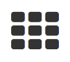
Form/action flow
Salfatix
Influencers App
Local
Back
Back
Menu
Deal
Detail
Menu
Login
Deal
List
Deal Detail
Use Credentials
Tap
Apply
Sorted list
My deals
Remove
Search
Like
Contact Us
Message
list
Table View
Messages
Menu
Create
Tap
Block View
Disconnect
Profile
Swipe right
Read
Edit
Profile
Remove
Back
Message

Slide 8
Login
Salfatix
Influencers App
Salfatix Media
Login
Password
Or
Or
New account
Forgot password

Slide 9



Edit
Profile
Profile
Profile
Salfatix
Influencers App
First Name
Youtube
Last Name
Facebook
Male
Female
Bank
Coordonnees
Company No
Email
Company Status
Phone No
Company Banking No
Postal Address
IBAN
Street
SWIFT
Town
Rates
ZIP Code
Your rate
Country
Description
Blog or Web Site
URL

Slide 10

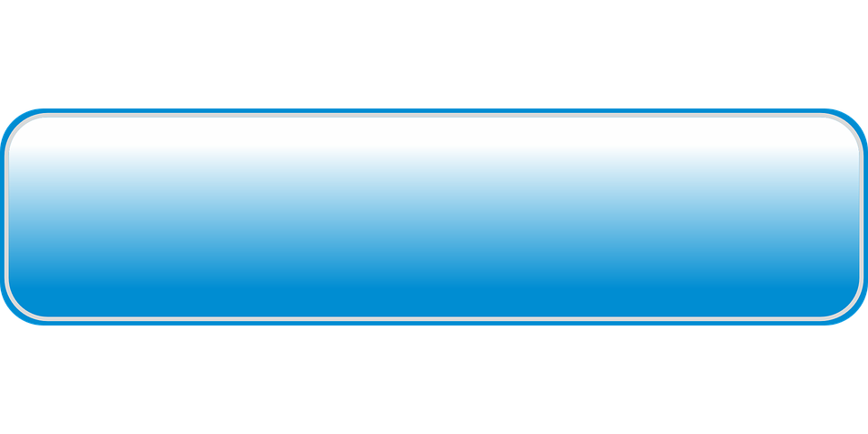
Edit
Profile
Profile
Salfatix
Influencers App
Notifications
eMails
Notes
eMail address has to be validated through eMail exchange
Only when eMail address is validated, the account is activated
The account is manually validated by Salfatix.
Other forms are available only after acceptance from Salfatix
SMS
Push
Legal
I have read and accept the general terms of use …
Update/Create
Delete account

Slide 11
Deal
List
Deals
Salfatix
Influencers App
Picture
Brand
Notes
Scroll up/down to navigate
Tap to see deal details
Swipe left to remove the deal from the list
Short Info
Picture
Brand
Short Info
Picture
Brand
Short Info
Picture
Brand
Short Info
Picture
Brand
Short Info
Picture
Brand
Short Info

Slide 12
Deal
List
Deals
Salfatix
Influencers App
Picture
Picture
Notes
Scroll up/down to navigate
Tap to see more details
Brand
Brand
Picture
Picture
Brand
Brand

Slide 13
Deal
Detail
Deals
Salfatix
Influencers App
Picture
Notes
Swipe left/right to navigate
Tap to see more details
Press accept button to accept the deal
Brand
Description
Apply

Slide 14
Form/action flow
Create
Back
Menu
Salfatix
Office App
Deals
Login
Products
Dashboard
Influencers
Influencers
Account
Requests
Graph
Number of influencers per month
Create Deals
Deals
Graph
Number of deals per month
Influencers
Influencers
Messages
User
Users
Messages
Graph
Number of active influencers / deals
Mailing
To Influencers
Open deals
Brand
Disconnect
Brands
Done
Deals
To check
Deal appliance
List

